Slide 1

HTML CSS
08.01.2024

Slide 2
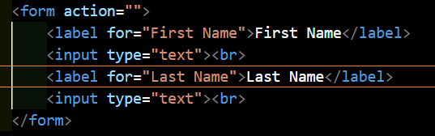
Forms

Slide 3
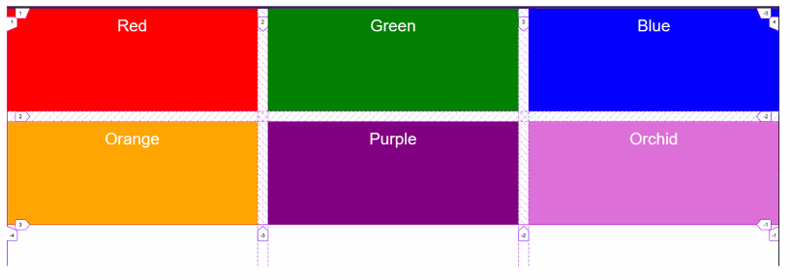
Grid

Slide 4
SASS
Variables –change once for all places
Nesting – a shorten way to wright css

